Slide 1
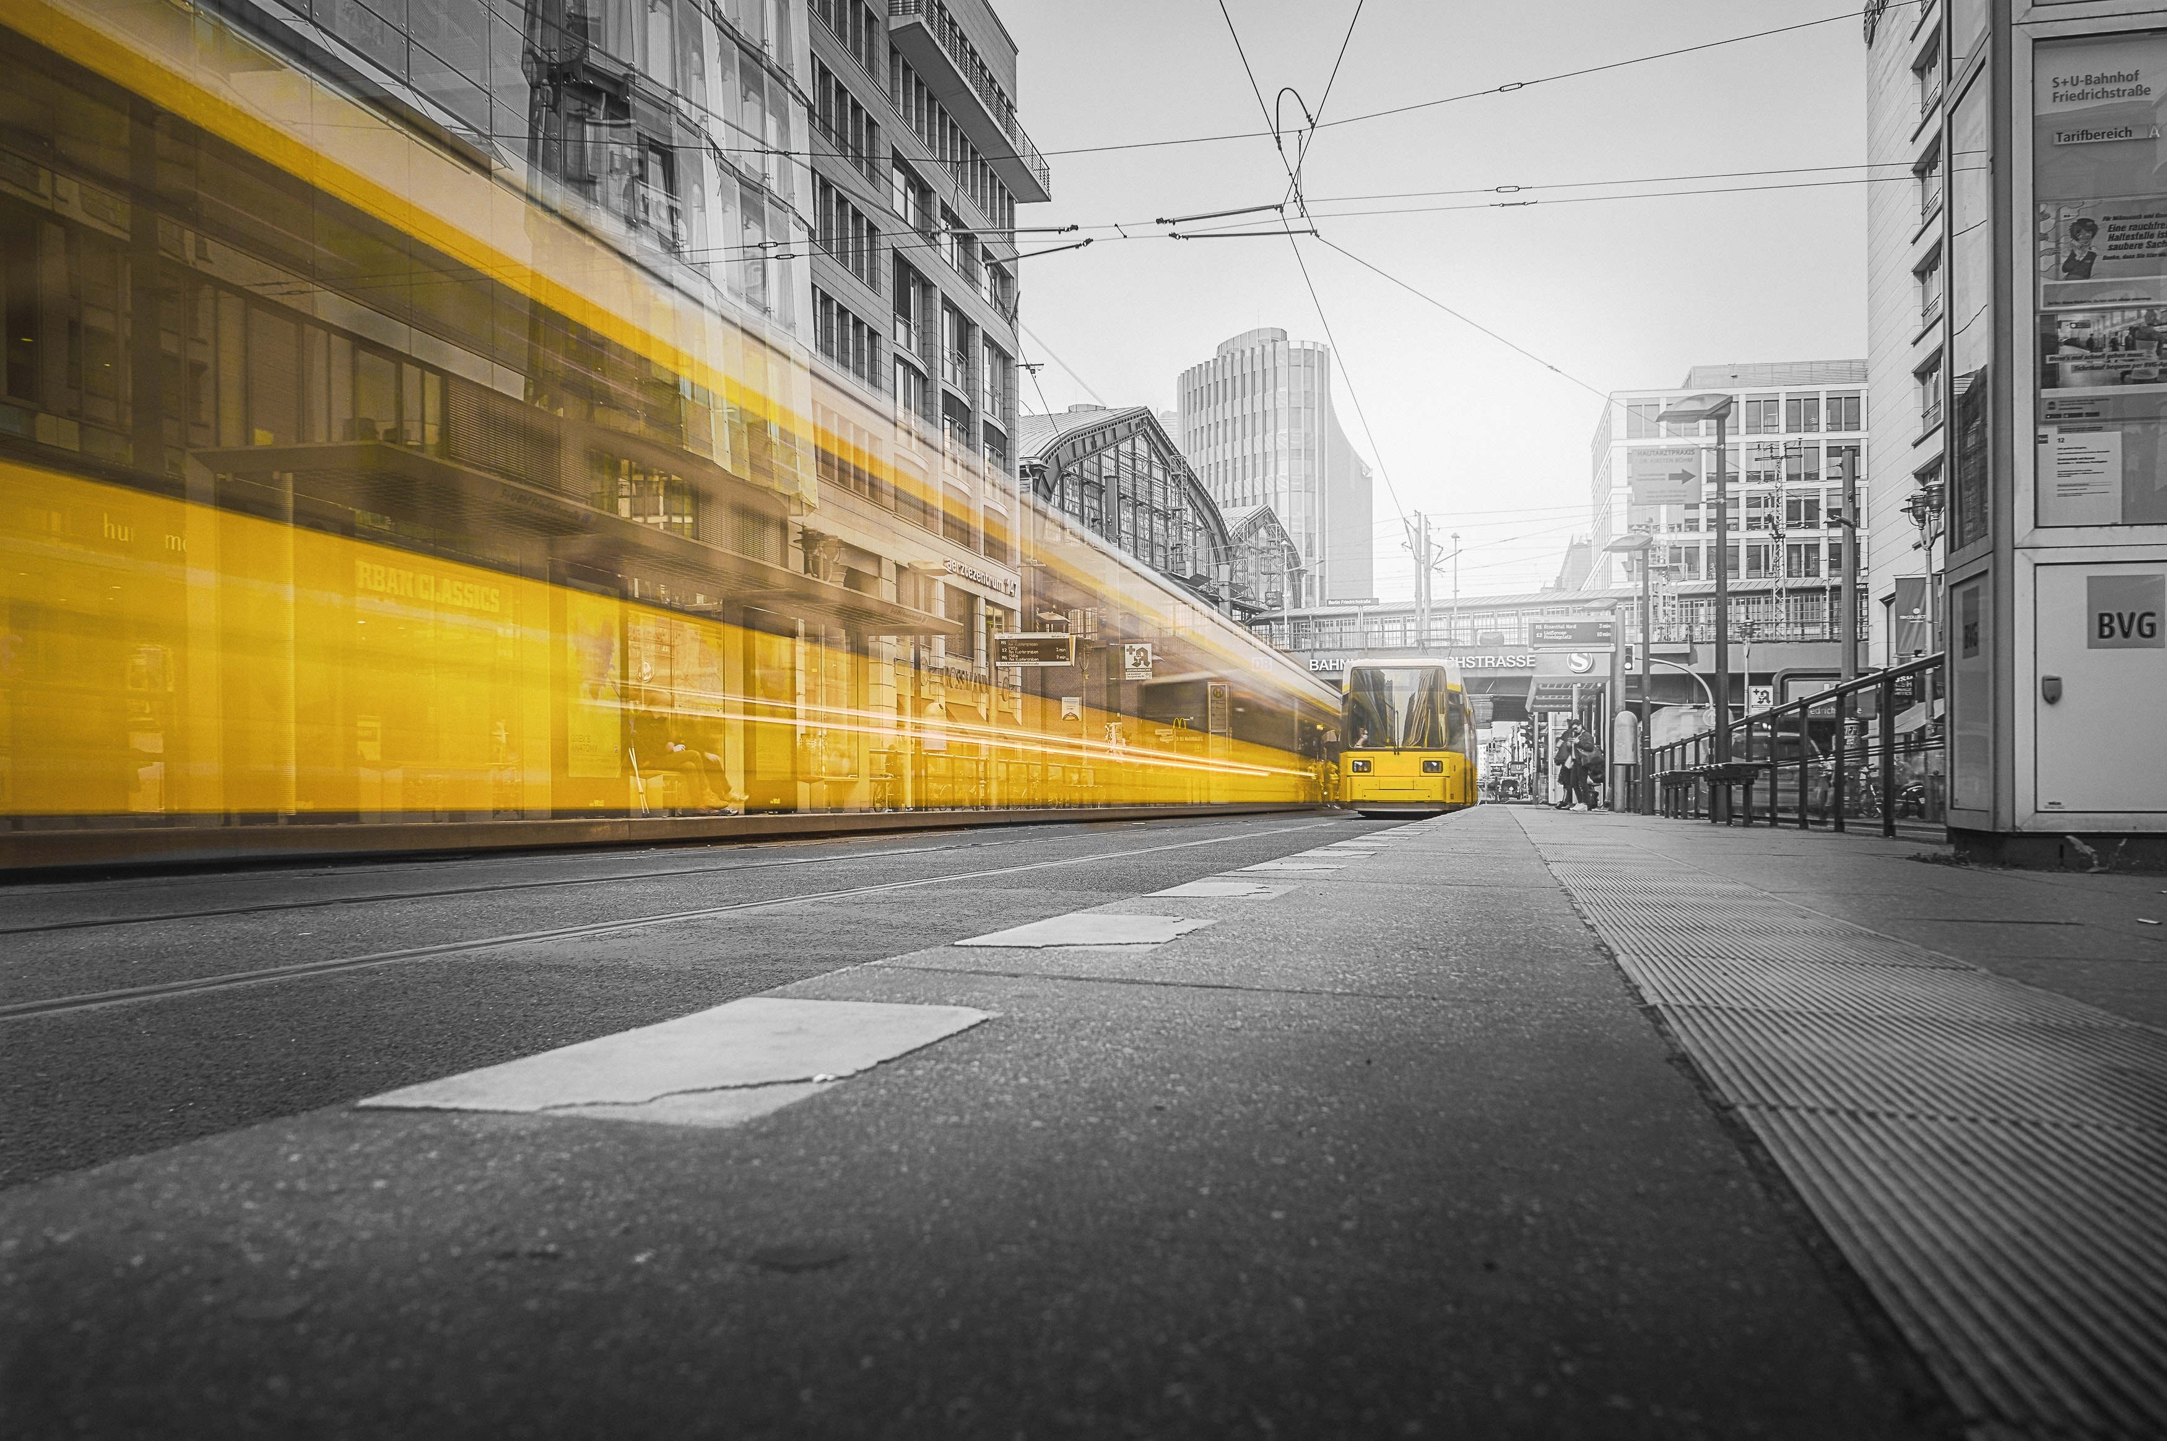
Coursera Data Science Capstone Project
The battle of the neighbourhoods – Module 9 Week 4

Slide 2
Brief / Hypothesis
I am currently living and working in Camden Town – London for a multinational employer who has offices around the world.
After much deliberation I decided that I wanted to experience living and working in another country and have just found out that I have been accepted for a role working in our Australian branch located in the City of Sydney.
As I enjoy living in Camden Town am I able to use what I have learned in my recent Coursera Data Science course to compare localities within the City of Sydney with the neighbourhoods of Camden town to help me look for a place like Camden to live?

Slide 3
Comparators
CAMDEN – LONDON
Belsize Park
Bloomsbury
Camden Town
Chalk Farm
Fitzrovia
Frognal
Gospel Oak
Hampstead
Highgate
Holborn
Kentish Town
Primrose Hill
Somerstown
St Giles
St Pancras
Swiss Cottage
West Hampstead
CITY OF SYDNEY - SYDNEY
Broadway
Central
Central Park
Chinatown
Circular Quay
Darling Harbour
The Domain
East Sydney
Garden Island
Goat Island
Green Square
Kings Cross
Macdonaldtown
Railway Square
Strawberry Hills
St James
Wynyard

Slide 4
Data Mapping and Process
Data Sources
CSV DATA - Latitude and Longitudes for both City of Sydney and Camden
FOURSQUARE – Venue information by locality
Method
Load CSV Data
Add information of local venues from foursquare using their developer portal (API)
Join the tables
Cluster the data based on venues
Review and draw a conclusion

Slide 5
Success factors & Considerations
How will success be measured?
By grouping ‘localities’ regardless of their City will allow for direct comparison
Known considerations potential blockers
Naming of venues might be different across social and geographical locations (i.e. between “Pubs” and “Bars”)
Affordability is not a consideration

Slide 6
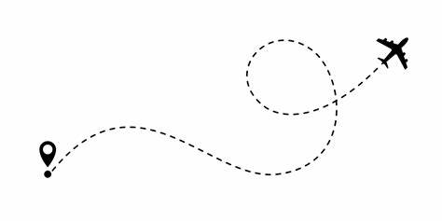
Results & Findings

Slide 7
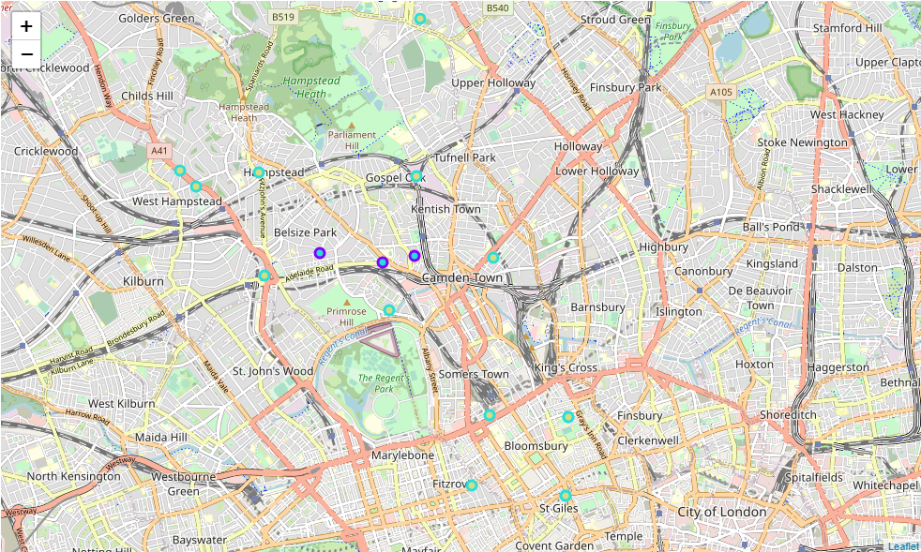
Results (London)
Consists of two clusters:-
Cluster 0 - Unique to London
Cluster 3 - Contains Neighbourhoods from both London and Sydney

Slide 8
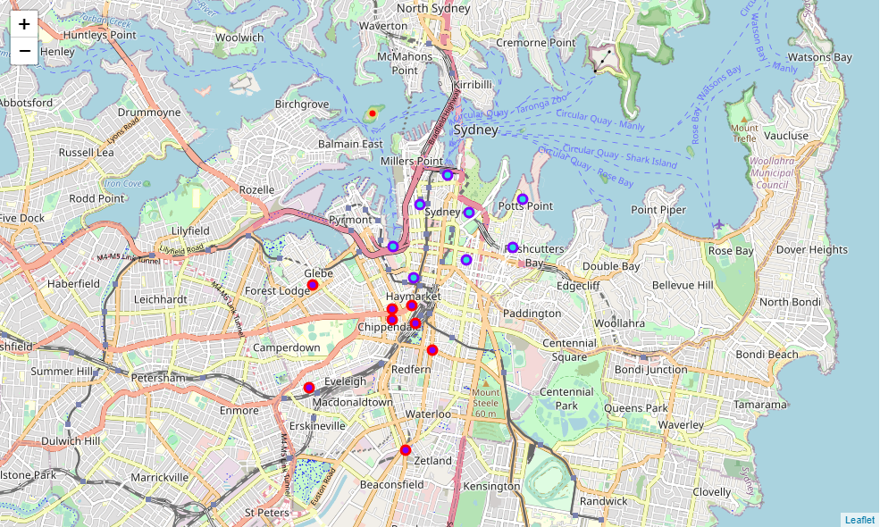
Results (Sydney)
Consists of 3 clusters:-
Cluster 1 - Unique to Sydney
Cluster 2 - Unique to Sydney
Cluster 3 - Contains Neighbourhoods from both London and Sydney

Slide 9
Conclusion
There is only one cluster which groups neighbourhoods from both Sydney and London and therefore is meets our criteria (Cluster 3) and should be visited first for re-locations assessment.
Cluster 3 is build up of 14 Neighbourhoods in total, 11 of which are in Sydney and 3 are in Camden.
Out of the 5 Clusters, 1 neighbourhood is totally unique and shares few characteristics with any other neighbourhood - Goat Island (Cluster 1)
2 area's are unique to their related Cities (Cluster 0 in London and Cluster 2 in Sydney)

Slide 10
Cluster 3 – Detail
INDEX | LOCALITY | NEIGHBOURHOOD | LATITUDE | LONGITUDE | Cluster Labels | 1st Most Common Venue | 2nd Most Common Venue | 3rd Most Common Venue | 4th Most Common Venue | 5th Most Common Venue | 6th Most Common Venue | 7th Most Common Venue | 8th Most Common Venue | 9th Most Common Venue | 10th Most Common Venue
0 | CAMDEN | Belsize Park | 51.545045 | -0.165609 | 3 | Café | Hotel Bar | Hotel | Pub | Italian Restaurant | Convenience Store | Market | Deli / Bodega | Plaza | Department Store
3 | CAMDEN | Chalk Farm | 51.543966 | -0.154115 | 3 | Café | Bar | Italian Restaurant | Pub | Pizza Place | Coffee Shop | Breakfast Spot | Music Venue | Clothing Store | French Restaurant
10 | CAMDEN | Kentish Town | 51.544774 | -0.148314 | 3 | Café | Pub | Market | Coffee Shop | Pizza Place | Flea Market | Bike Shop | Street Food Gathering | Breakfast Spot | Speakeasy
20 | CITY OF SYDNEY | Chinatown | -33.878502 | 151.204453 | 3 | Thai Restaurant | Japanese Restaurant | Hotel | Korean Restaurant | Café | Chinese Restaurant | Coffee Shop | Malay Restaurant | Ice Cream Shop | Sandwich Place
21 | CITY OF SYDNEY | Circular Quay | -33.862087 | 151.211000 | 3 | Café | Hotel | Cocktail Bar | Steakhouse | Australian Restaurant | Ice Cream Shop | Restaurant | Japanese Restaurant | History Museum | Speakeasy
22 | CITY OF SYDNEY | Darling Harbour | -33.873585 | 151.200485 | 3 | Hotel | Café | Japanese Restaurant | Thai Restaurant | Sushi Restaurant | Museum | Grocery Store | Burger Joint | Pub | French Restaurant
23 | CITY OF SYDNEY | The Domain | -33.868187 | 151.215057 | 3 | Café | Sandwich Place | Fountain | Steakhouse | Tunnel | Playground | Plaza | Dessert Shop | Hotel | Park
24 | CITY OF SYDNEY | East Sydney | -33.875622 | 151.214615 | 3 | Café | Japanese Restaurant | Pizza Place | Bakery | Bar | Italian Restaurant | Cocktail Bar | Park | Pub | Beer Bar
25 | CITY OF SYDNEY | Garden Island | -33.866000 | 151.225388 | 3 | Café | Chinese Restaurant | Park | Australian Restaurant | Trail | Vegetarian / Vegan Restaurant | Monument / Landmark | Steakhouse | Supermarket | Bookstore
28 | CITY OF SYDNEY | Kings Cross | -33.873730 | 151.223570 | 3 | Café | Italian Restaurant | Coffee Shop | Australian Restaurant | Pub | Pizza Place | Thai Restaurant | Sushi Restaurant | Hotel | Japanese Restaurant
33 | CITY OF SYDNEY | Wynyard | -33.866798 | 151.205750 | 3 | Café | Bar | Cocktail Bar | Coffee Shop | Speakeasy | Hotel | Sandwich Place | Bakery | Restaurant | Italian Restaurant

